Slide 1


Annual
Convention and
Exposition
#mculace
CFPB - IMPACT
Part I
May 16, 2013 9:00 – 10:00 a.m.
Facilitated by Shawn Wolbert, CIA, CUCE
www.mcul.org

Slide 2
AGENDA
International Remittance Transfers
Copies of Appraisals – Reg. B
Interagency Appraisal Rules
Escrow Requirements – Reg. Z
Loan Originator Compensation – Reg. Z
www.mcul.org
#mculace

Slide 3

I
mplementing
M
anaging
P
ossible
A
ctions
C
ritical
T
oday / Tomorrow
www.mcul.org
#mculace

Slide 4
International
Remittance
Transfers
www.mcul.org
#mculace

Slide 5

IRTs - Requirements
Disclosure
Cancelation
Error Resolution
www.mcul.org
#mculace

Slide 6
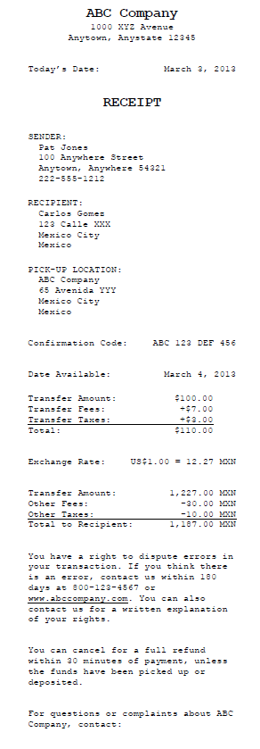
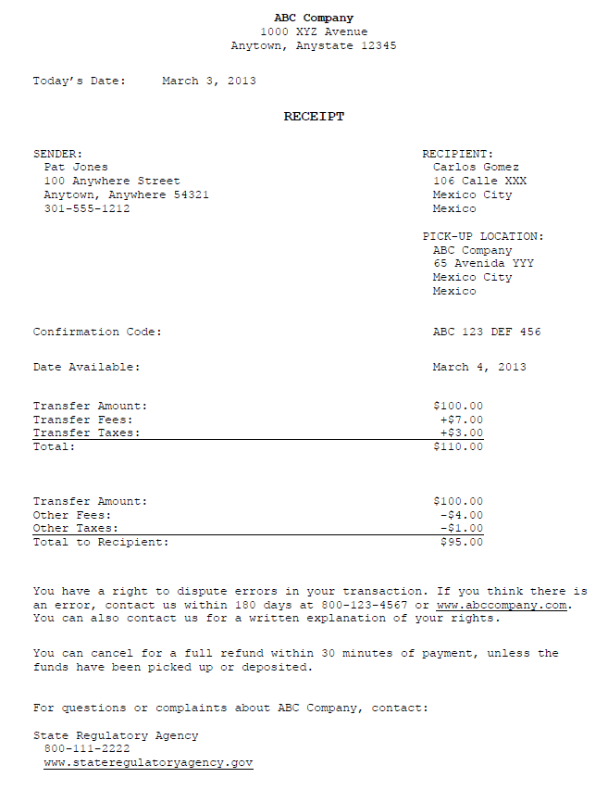
IRTs - Disclosure
www.mcul.org
#mculace

Slide 7

IRTs - Cancelation
Members get 30 minutes to cancel a transfer.
www.mcul.org
#mculace

Slide 8
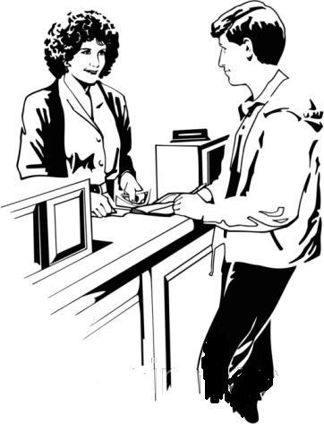
IRTs – Error Resolution
Credit union must:
Investigate problems
If an error occurred….
    Make the transaction whole
    Give the member a refund
www.mcul.org
#mculace

Slide 9

IRTs – Exemption
Less than 100 IRTs in a calendar year
EXEMPT
www.mcul.org
#mculace

Slide 10

IRTs – the CFPB’s Process
CFPB becomes regulator of
Electronic Funds Transfer Act
July 21, 2011
www.mcul.org
#mculace

Slide 11
IRTs – the CFPB’s Process
CFPB finalizes International Remittance Transfer Rule
&
CFPB proposes amendments to the IRT Rule
July 21, 2011
www.mcul.org
#mculace

Slide 12
IRTs – the CFPB’s Process
CFPB Finalizes 100 IRT Exemption
August 7, 2012
www.mcul.org
#mculace

Slide 13
IRTs – the CFPB’s Process
CFPB proposes additional amendments to the IRT Rule
November 27, 2012
www.mcul.org
#mculace

Slide 14
IRTs – the CFPB’s Process
CFPB Temporary Delay of Rule
&
Request for Comment
January 22, 2013
www.mcul.org
#mculace

Slide 15
IRTs – the CFPB’s Process
International Remittance Transfer Rule
Effective Date
90 Days After the Final Rule
www.mcul.org
#mculace

Slide 16
www.mcul.org
#mculace

Slide 17
COPIES
OF
APPRAISALS
1/18/2014
www.mcul.org
#mculace

Slide 18
Copies of Appraisals
Amends:
          Equal Credit Opportunity Act
          (Regulation B)
www.mcul.org
#mculace

Slide 19

Copies of Appraisals
Credit Union must furnish copies of appraisals and other written valuations to members for their first lien loans secured by a dwelling.
www.mcul.org
#mculace

Slide 20
Copies of Appraisals
Notify members within 3 days of application of their right to receive a copy of appraisal.
Provide copy of appraisal promptly upon completion or 3 days prior to loan closing.
Members can waive 3 day timing requirement.
CU cannot charge for the appraisal copy.
www.mcul.org
#mculace

Slide 21
www.mcul.org
#mculace

Slide 22
Interagency
Guidance
On HPML
APPRAISALS
1/18/2014
www.mcul.org
#mculace

Slide 23
HPML Appraisals
Amends:
          Truth in Lending Act
          (Regulation Z)
www.mcul.org
#mculace

Slide 24
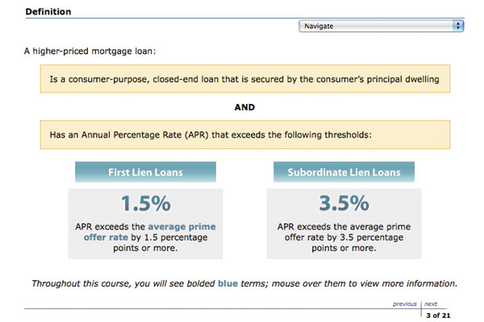
HPML Appraisals
For Higher Priced Mortgage Loans
Only applies to closed-end credit transactions.
www.mcul.org
#mculace

Slide 25
HPML Appraisals
For Higher Priced Mortgage Loans:
  The creditor must obtain a written appraisal;
  The appraisal is performed by a certified or licensed appraiser; and
  The appraiser conducts a physical property visit of the interior of the property.
www.mcul.org
#mculace

Slide 26
HPML Appraisals
Credit Union Requirements:
  Written notice of appraisal and member rights; and
  Free copy of appraisal – just like CFPB.
www.mcul.org
#mculace

Slide 27
HPML Appraisals
Property Flippers:
  Obtain a second written appraisal based on an interior inspection of the property, at no cost to the borrower.
www.mcul.org
#mculace

Slide 28
HPML Appraisals
Property Flippers:
  Second appraisal required if:
  The seller acquired the home within 180 days prior to the date of the consumer’s purchase agreement; and
  The consumer is acquiring the home for a price that exceeds the seller’s acquisition price by 10% (if the seller acquired the property within the past 90 days) or 20% (if the seller acquired the property between 91 and 180 days earlier).
www.mcul.org
#mculace

Slide 29
HPML Appraisals
Exemptions:
  Qualified mortgages;
  All reverse mortgages;
  Loans for initial construction of a dwelling;
  Temporary bridge loans (for 12 months or less);
  Loans secured by a new manufactured homes; and
  Transactions secured by a mobile home, boat, or trailer.
www.mcul.org
#mculace

Slide 30
www.mcul.org
#mculace

Slide 31
Escrow
Requirements
6/1/2013
www.mcul.org
#mculace

Slide 32
Escrow Requirements
Amends:
          Truth in Lending Act
          (Regulation Z)
www.mcul.org
#mculace

Slide 33

Escrow Requirements
Must establish an escrow account for “higher-priced mortgage loan” and maintain it for 5 years.
www.mcul.org
#mculace

Slide 34
Escrow Requirements
Higher-priced mortgage loan:
Closed end consumer credit transaction secured by a members principal dwelling with an annual % that exceeds the average prime offer rate.
www.mcul.org
#mculace

Slide 35

Escrow Requirements
Higher-priced mortgage loan:
1.5% - First lien that does not exceed max principal obligation limit
2.5% - First lien that does exceed limit
3.5% - Subordinate liens
www.mcul.org
#mculace

Slide 36
Escrow Requirements
Small Creditor Exemption:
Make more than half first-lien mortgages in rural or underserved areas;
Have an asset size less than $2 billion; Together with its affiliates, have originated 500 or fewer first-lien mortgages during the preceding calendar year; AND
Together with its affiliates, not escrow for any mortgage it or its affiliates currently services, except in limited instances.
www.mcul.org
#mculace

Slide 37
Escrow Requirements
Rural & Underserved Area?
Safe harbor for relying on the CFPB’s list of counties that qualify as rural or underserved.
“The Bureau will post on its public Web site the applicable lists for each calendar year by the end of that year.” (pg. 4756)
www.mcul.org
#mculace

Slide 38


Escrow Requirements
Small Creditor Exemption does not apply to mortgages originated for forward commitment.
www.mcul.org
#mculace

Slide 39
www.mcul.org
#mculace

Slide 40
Loan
originator
compensation
1/10/2014
www.mcul.org
#mculace

Slide 41
Loan Originator Compensation
Amends:
          Truth in Lending Act
          (Regulation Z)
www.mcul.org
#mculace

Slide 42
Loan Originator Compensation
MLO cannot receive compensation based on the terms of the transaction.
MLO cannot receive compensation based on the interest rate of a loan or on the fact that the loan officer steered a consumer to purchase required title insurance from an affiliate of the credit union.
www.mcul.org
#mculace

Slide 43

Loan Originator Compensation
No Dual Compensation
If MLO receives compensation form the member in connection with a mortgage loan – he/she cannot receive compensation from the credit union or another person for the same transaction.
www.mcul.org
#mculace

Slide 44
Loan Originator Compensation
MLOs’ must be registered or licensed according to the Secure and Fair Enforcement of Mortgage Licensing Act.
MLO’s must provide their unique identifier # on loan documents along with their name.
www.mcul.org
#mculace

Slide 45

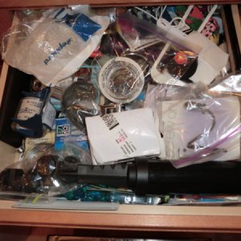
Loan Originator Compensation
www.mcul.org
#mculace

Slide 46

Loan Originator Compensation
Binding arbitration requirements are prohibited.
It also prohibits the application or interpretation of provisions of such loans or related agreements so as to bar a consumer from bringing a claim in court in connection with any alleged violation of Federal law.
www.mcul.org
#mculace

Slide 47

Loan Originator Compensation
Credit Insurance
Prohibits the financing of any premiums or fees for credit insurance (such as credit life insurance) in connection with a consumer credit transaction secured by a dwelling, but allows credit insurance to be paid for on a monthly basis.
www.mcul.org
#mculace

Slide 48
www.mcul.org
#mculace

Slide 49

www.mcul.org
#mculace

Slide 50
Annual
Convention and
Exposition
#mculace
Shawn Wolbert, CIA, CUCE
MCUL & Affiliates
Shawn.Wolbert@MCUL.org
Phone/Web/Social Media
www.mcul.org

